Slide 1




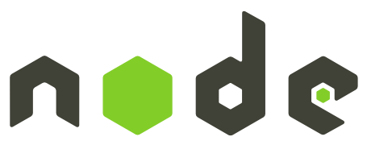

JavaScript: ExpressJS Overview
Node.JS, ExpressJS, Handlebars, MVC in JavaScript
ExpressJS
SoftUni Team
Technical Trainers
Software University
http://softuni.bg

Slide 2
Contents
Node.JS
  Overview, Purpose
ExpressJS
  What is ExpressJS?
  Routes
  Controllers
  Views – using handlebars.js

Slide 3
Have a Question?
sli.do
#tech-softuni

Slide 4
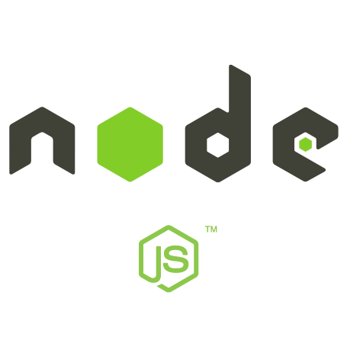
Node.JS
Server-side JavaScript runtime

Slide 5
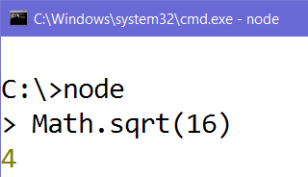
Node.JS – What is it?
Node.JS – JavaScript runtime environment
  Run JavaScript from the console
  Flexible – can use various modules
  Scalable – works well for both
  small and large workloads
  Can act as a Web Server

Slide 6
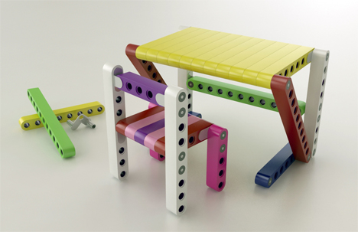
Node.JS - Advantages
Developers can use whatever they want for:
  Middleware
    Authentication, Cookies, Sessions (User Login State)
  Database connection + ORM (DB to Entity)
    Mongoose, Sequelize, Bookshelf, etc.
  Template (view) engines
    Handlebars, Pug, Mustache, etc.

Slide 7
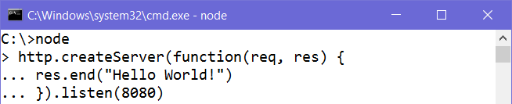
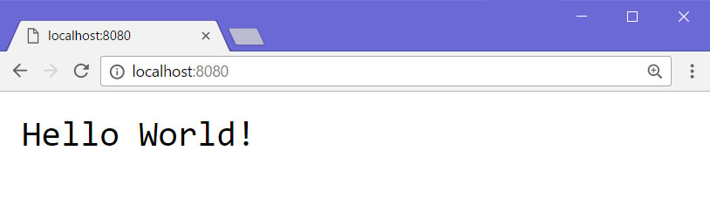
Node.JS Example – Simple Web server
Anonymous function
Send a response
Listen on port 8080
Request URL
HTTP Response
(rendered as web page)

Slide 8
ExpressJS
Web Framework for Node.JS

Slide 9


What is ExpressJS?
Web framework for Node.JS
Handles GET, POST requests
Error handling (bad request, not found, unauthorized)
Advanced routing (parameters and wildcards supported)
Parameters
Wildcard (anything)
Parameters

Slide 10
ExpressJS Routing
Specify HTTP Request method (GET/POST)
Function to execute when route is matched
Express instance
URI (path on server)
Request & Response

Slide 11
MVC Pattern
Using Node.JS, ExpressJS, Handlebars, Mongoose

Slide 12
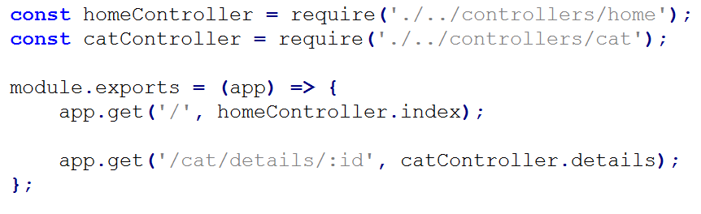
Routes – routes.js
Routes.js allows us to tell ExpressJS which routes trigger which controller actions
Import the cat controller
Handles GET requests
Route to listen on
Call the details function

Slide 13
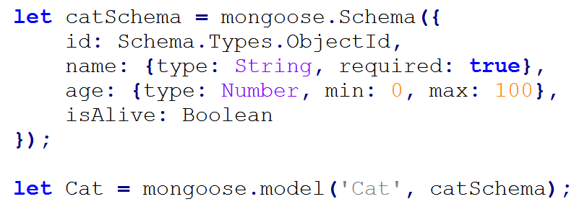
Model – Mongoose
Using Mongoose, we can define our model schema:
Unique ID
Model properties
Validation
Model name

Slide 14
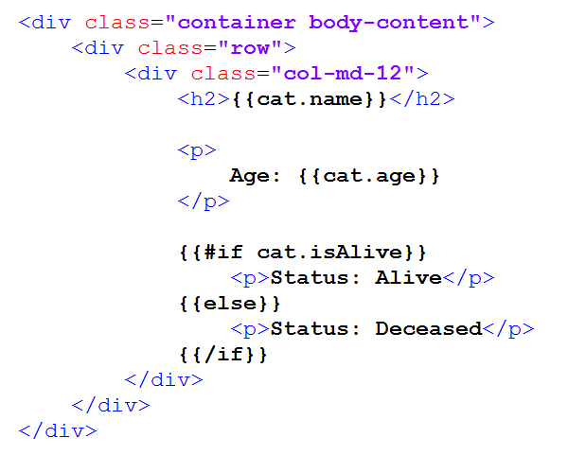
View – Handlebars
HTML views with Handlebars templating syntax:
Handlebars syntax
Handlebars syntax
HTML Code
Handlebars if/else

Slide 15
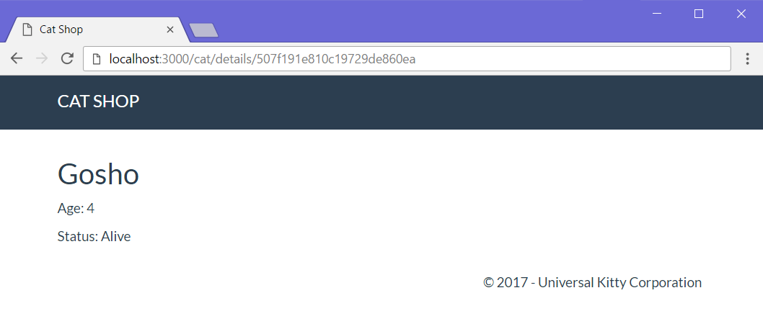
View – Handlebars (2)
Route: /cat/details/
req.params.id
{{cat.name}}
{{cat.age}}

Slide 16
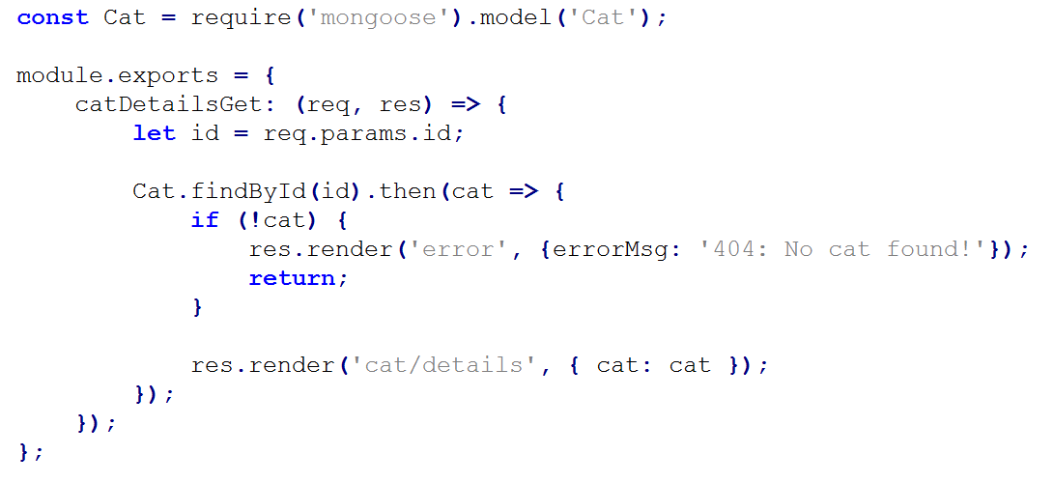
Controller – ExpressJS
Example – catController.js:
Import the Cat model
Controller action
Find cat in DB by id
Render error view
Render cat/details view
Pass parameters to view

Slide 17
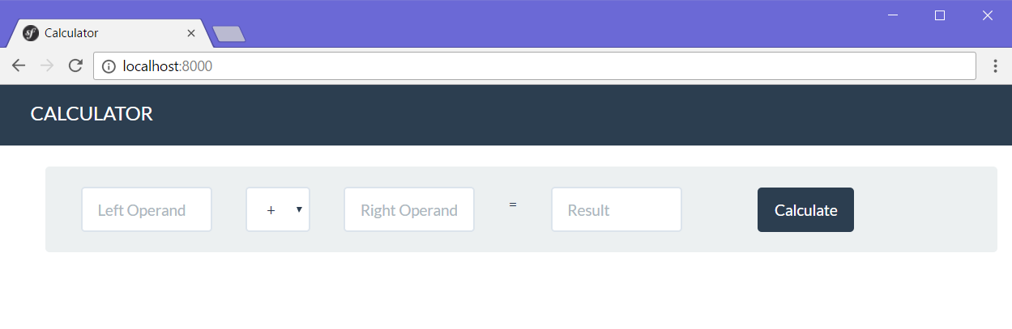
Problem: Simple Calculator Web Application
Write a web application, which can calculate the result between two operands
  Implement addition, subtraction, multiplication and division

Slide 18

Web application with ExpressJS
Live Exercises in Class (Lab)

Slide 19

Summary
Node.JS
  JavaScript runtime environment
  Establishes communication between the server, and the client
ExpressJS
  Web framework for Node.JS
Implementing the MVC pattern with JavaScript
  Using Node.JS, Mongoose, ExpressJS and Handlebars

Slide 20








JavaScript: ExpressJS Overview
https://softuni.bg/courses/software-technologies/

Slide 21
License
This course (slides, examples, demos, videos, homework, etc.)
is licensed under the "Creative Commons Attribution-NonCommercial-ShareAlike 4.0 International" license

Slide 22





Trainings @ Software University
Software University Foundation – softuni.org
Software University – High-Quality Education, Profession and Job for Software Developers
  softuni.bg
  Software University @ Facebook
  facebook.com/SoftwareUniversity
  Software University Forums – forum.softuni.bg

